Slide 1
Hatches and Holes Design Impacts on Underground Structures
Precast Concrete Association of New York
Ronald Thornton, P.E.
Executive Director

Slide 2
Learning Objectives
Review the general principles and ASTM standards involved in the design of round, square, and rectangular structures
Discuss ACI 318 and PCI provisions regarding openings in slab systems
Identify various types of access devices including hatches, grates, & manhole frames and how live loads applied to these devices are transferred to the slab
Review pipe-to-wall connections such as mortar, gasket, & flanged sleeves
Establish limitations and measures for replacing interrupted reinforcing steel
Location of wall openings relative to horizontal joints

Slide 3
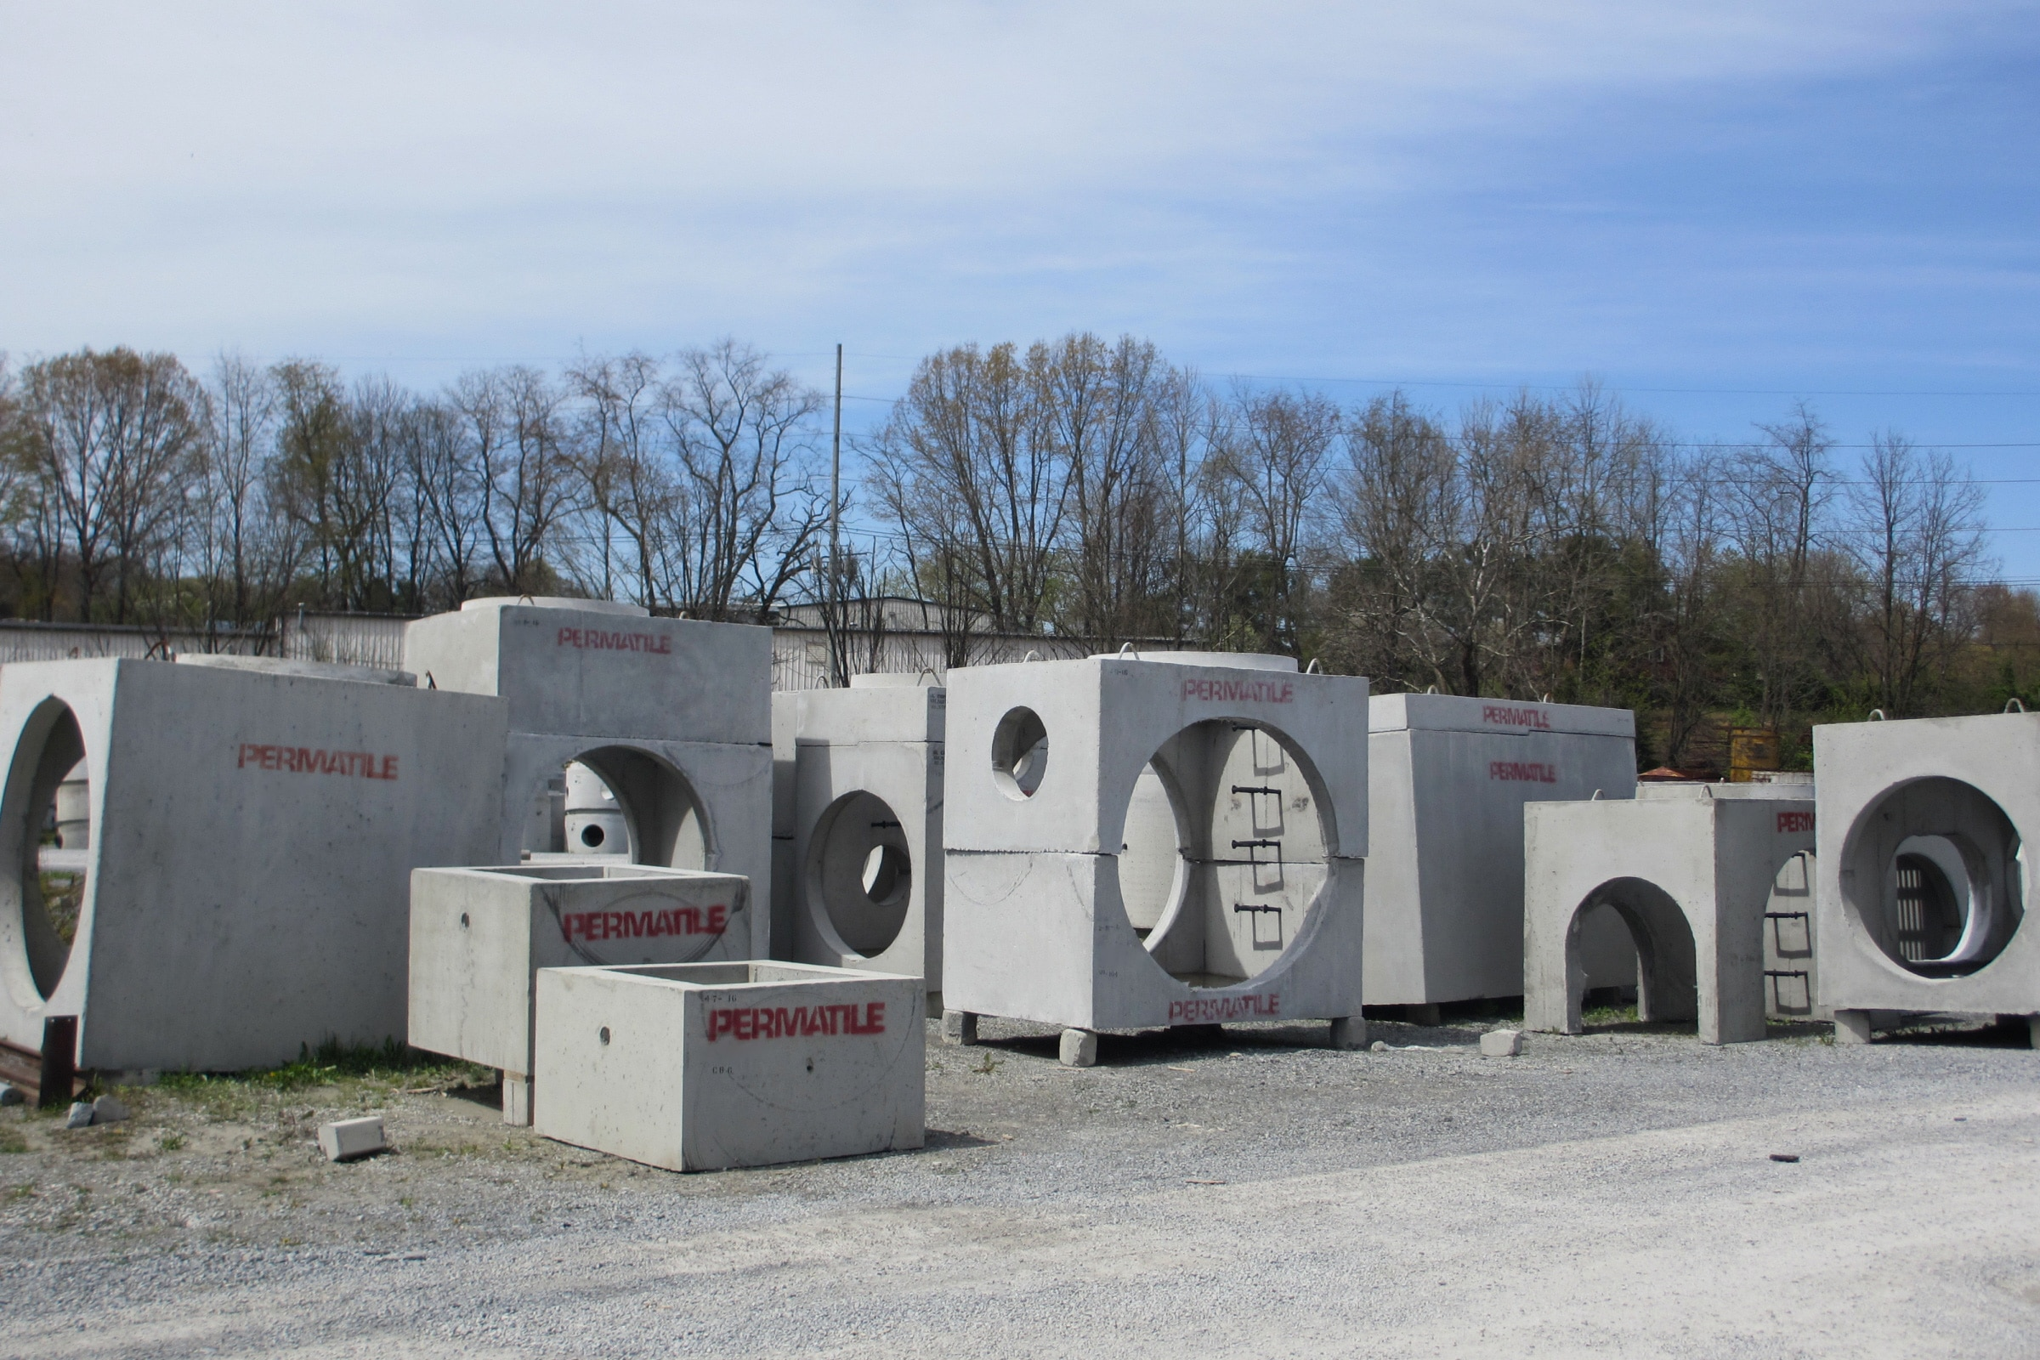
Holes and Hatches
Almost all underground structures require some type of opening

Slide 4
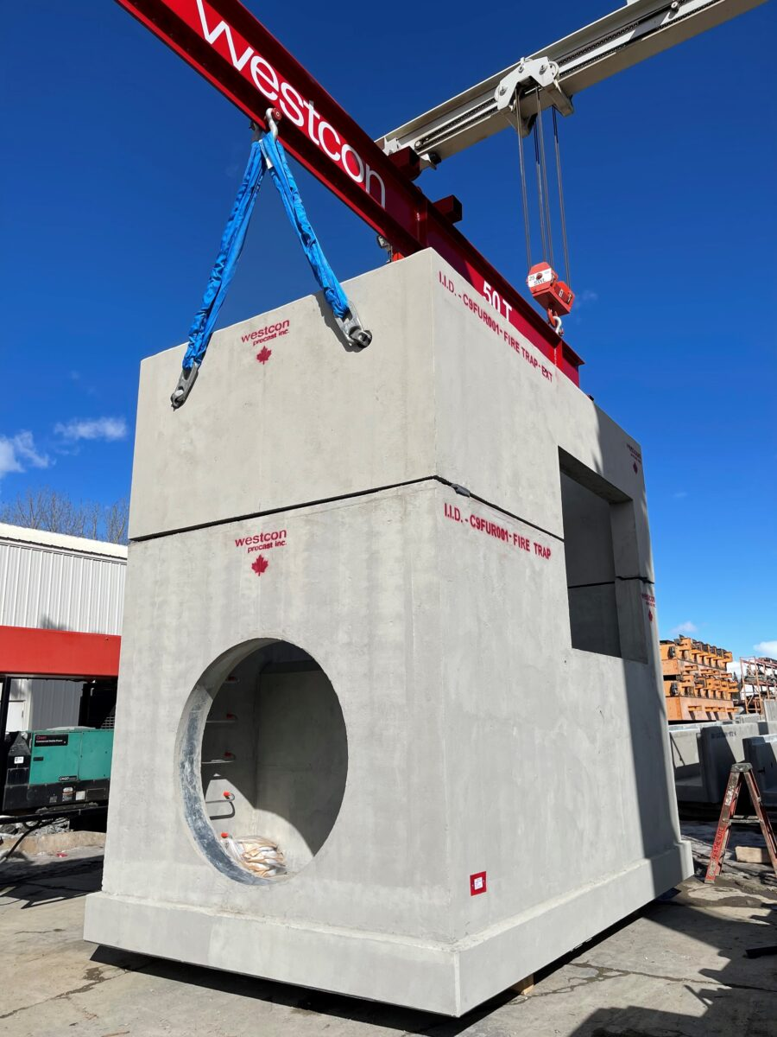
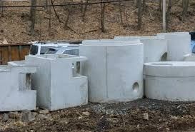
Holes and Hatches
Corner-outs like this should be avoided

Slide 5
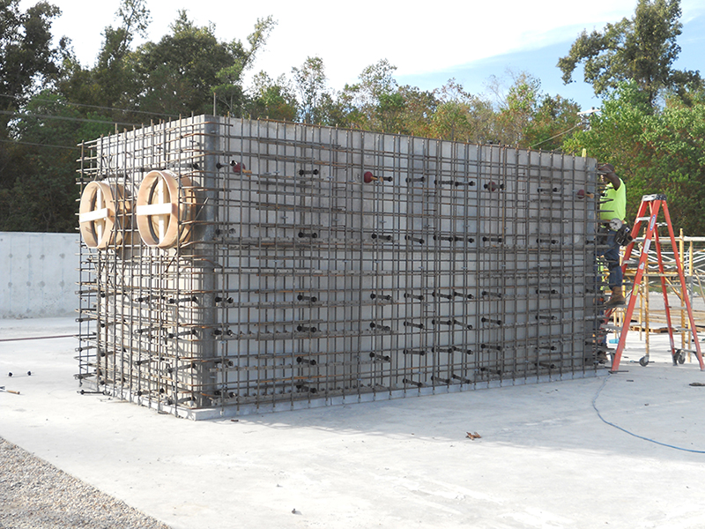
Holes and Hatches
Openings need to be properly reinforced

Slide 6
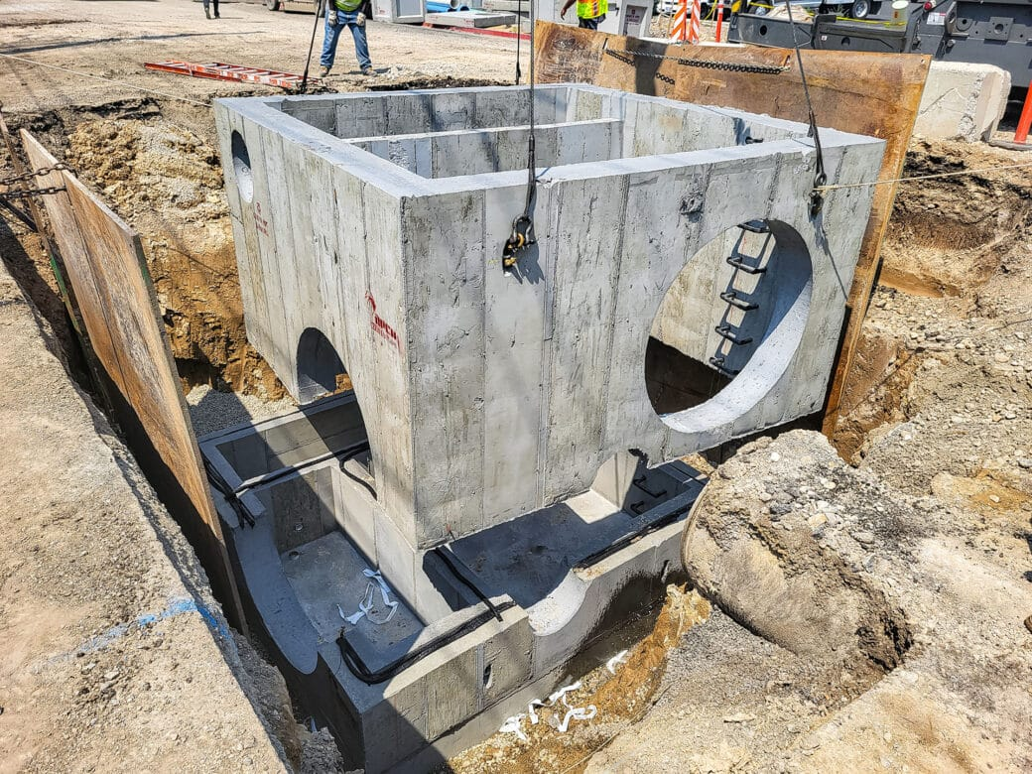
Holes and Hatches
Should openings cross a horizontal joint?
Openings can also affect lifting & rigging
We will discuss

Slide 7
ASTM Standards for Precast Underground Structures
Materials & Manufacturing ASTM | Related Products | Loads | Design Standard
C478 | Round Manholes | N/A | ACI 318
C858 | Utility Structures | C857 | ACI 318
C913 | Water & Wastewater Structures | C890 | ACI 318
C1227 | Septic Tanks | C890* | ACI 318
C1613 | Grease Traps | C890 | ACI 318
*C1227 specifies lighter loads for residential tanks

Slide 8
Other Design & Load Specifications
AASHTO LRFD – ASTM C1889
HL93 Loading
Aircraft Loads – FAA Circular 5320-6G, Appendix B
Railroad Loading – AREMA (American Railway Engineering and Maintenance-of-Way Association)
Cooper E80
ACI 350 – Environmental Engineering Structures
State DOT Specifications

Slide 9
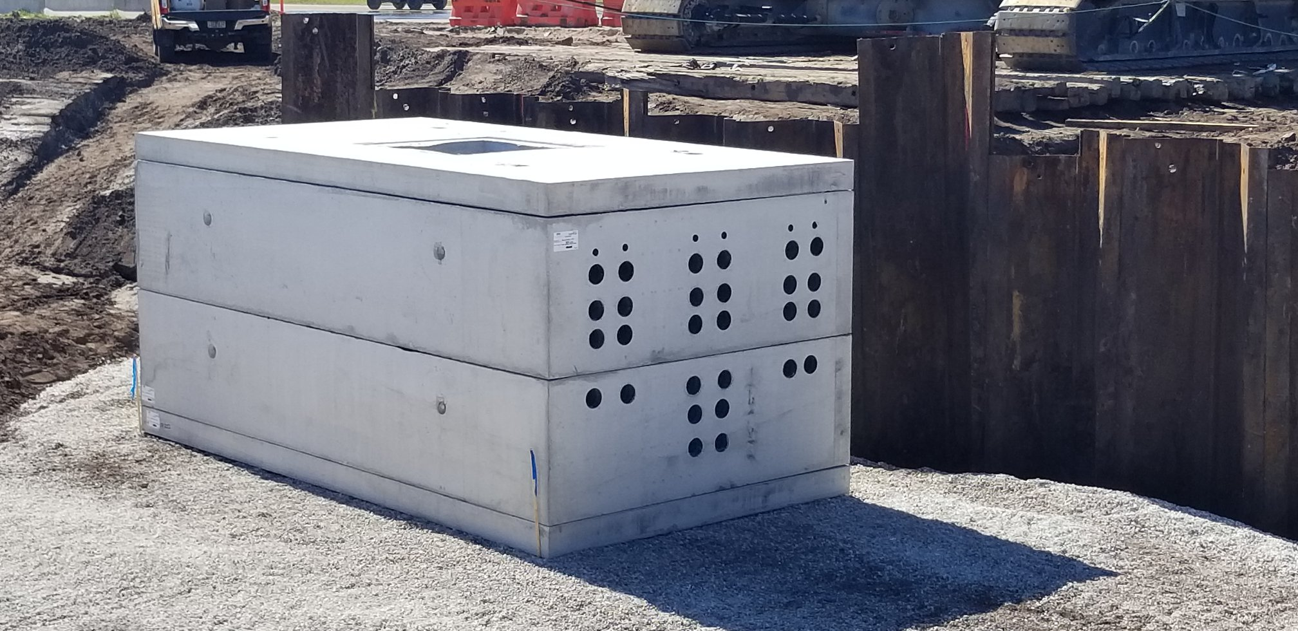
Design of Underground Vaults
TOP SLAB
Break down a structure to individual members
Top Slab
Walls
Mono Top
Risers
Mono/Integral Base
Base slab
WALLS
BASE SLAB

Slide 10
Design of Underground Vaults
Two (2) Basic Load Types
Concentrated
Uniform or Superimposed
Concentrated Load
P (lbs)
Uniform or Superimposed load, w(lbs/sf)

Slide 11
Design of Underground Vaults
Define Load Types and Categories
ACI 318 Designations
Dead Loads, D
Live Loads, L
Lateral Earth & Hydrostatic Loads, H
Seismic, E
Wind, W
Snow, S

Slide 12
Design of Underground Vaults
ACI 318 Load Combinations
U = Ultimate Load
1.4D
1.2D + 1.6L + 0.5S
0.9D + 1.0E
1.6H

Slide 13
Design of Underground Vaults
TOP SLAB
Top Slab Design
Traffic Loads
Non-Traffic (Pedestrian)

Slide 14

Design of Underground Vaults
Traffic Loads
H20
HS20
HS20-44
HS20 Plus 30% Impact
THERE IS NO DIFFERENCE!!!

Slide 15
Design of Underground Vaults
Vehicle Loads
ASTM C857
ASTM C890
Top slab designs are typically based on a single wheel load
Earth fill3 <2’ are considered concentrated
Earth fills >2’ are distributed through fill

Slide 16
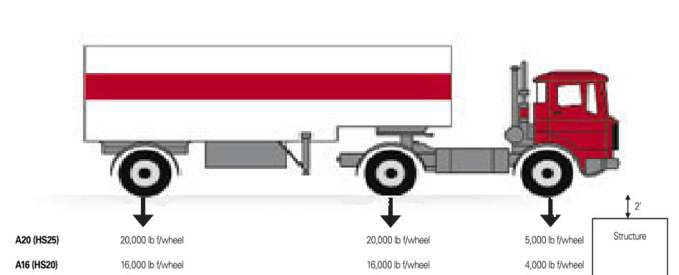
Design of Underground Vaults
Vehicle Loads
(A16 Load)
Grade
2’-0”

Slide 17
Design of Underground Vaults
Walls
Top Slab
Walls
Mono Top
Risers
Mono/Integral Base
Base slab
JOINTS

Slide 18
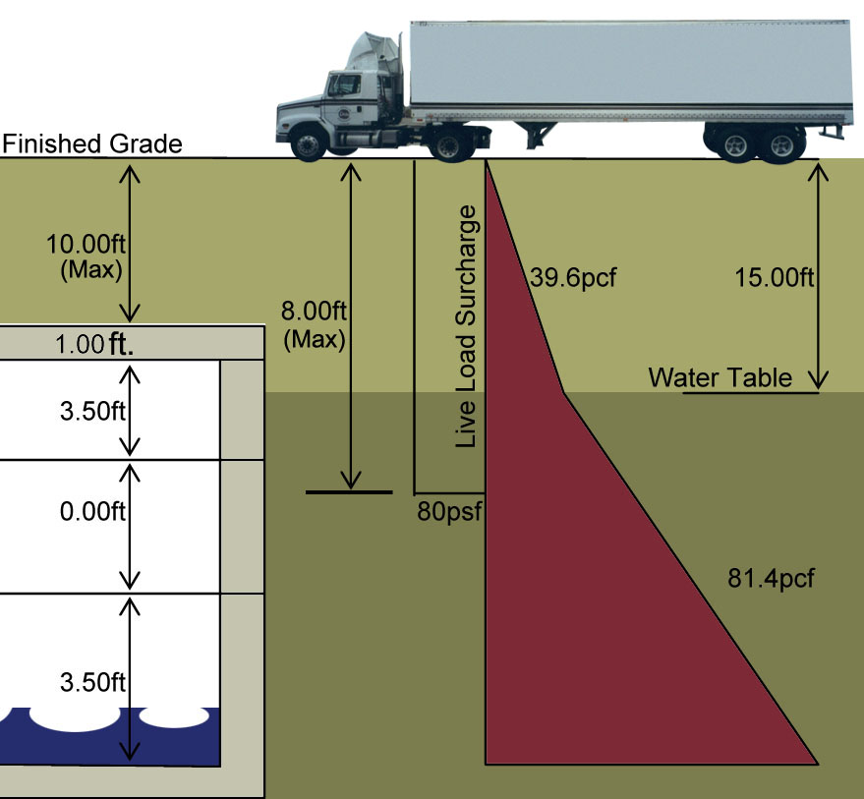
Design of Underground Vaults
Lateral Earth Loads
Active earth pressure above and below water table
Load increases with depth
Live load surcharge
Considered uniform for simplicity
Effective lateral soil pressure more than doubles below the water table depth

Slide 19
Design of Underground Vaults
Base Slab
BASE SLAB

Slide 20





Design of Underground Vaults
$$P_{w}$$
Base Slab
Add all Downward Forces
Total Number of Wheels
+ Total Earth Fill
+ Self Weight of Structure
- Base slab weight
Divide by area of base slab
$$W_{b}=\frac{ΣF_{v}}{L x W}$$
$$W_{b}$$

Slide 21
Reinforced Concrete Design
Concrete Thickness
Sufficient to meet minimum reinforcement cover and withstand design loading conditions.
Reinforcement
Reinforcement design by structural calculations as required by code or as proven by testing.

Slide 22
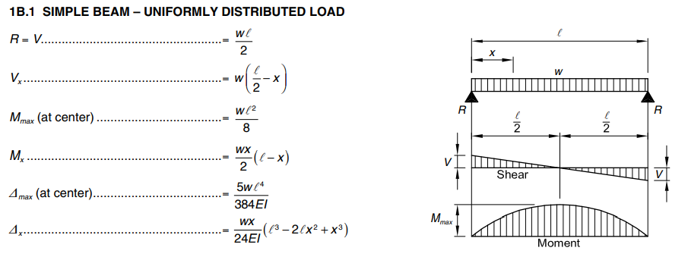
Reinforced Concrete Design

Slide 23
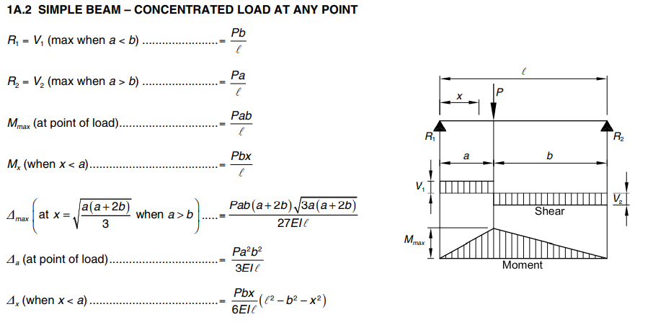

Reinforced Concrete Design
$$M_{max}\left(a=b\right)……….=\frac{pl}{4}$$

Slide 24
Reinforced Concrete Design
Ultimate Forces
= Σ Dead & Live Load Moment & Shear Forces x Applicable Load Factors

Slide 25









Reinforced Concrete Design
Capacity or Nominal Moment
$∅M_{n}=∅A_{s} x F_{y} x \left(d−\frac{a}{2}\right)$
$∅=0.9 (Capacity reduction factor)$
$$εc=0.003$$
$$0.85{f′}_{c}$$
c
$$a=β_{1}c$$
d
$$d−\frac{a}{2}$$
$$Thickness$$
t
$$ε_{s}=\frac{F_{y}}{E_{s}}$$
$$F_{y}A_{s}$$
$$F_{y}A_{s}$$
Bar Cover

Slide 26





Reinforced Concrete Design
$$A_{s}=Area−of−Steel$$
Slab
#5 @ 9”oc
Bar Size | Diameter (in) | A_{b} (in²)
3 | 3/8” = .375 | .11
4 | ½” = .500 | .20
5 | 5/8” = .625 | .31
6 | ¾” =.750 | .44
7 | 7/8” =.875 | .60
8 | 1.00 | .79
9 | 1.128 | 1.00
10 | 1.270 | 1.27
11 | 1.410 | 1.56
$$A_{s}=\frac{A_{b}×12}{Spacing}$$
$$A_{s}=\frac{0.31{in}^{2}×12"}{9"}=0.41{in}^{2}/ft$$
Beam
(3) # 6 Bars
$$A_{s}=A_{b}×Number of Bars$$
$$A_{s}=0.44×3=1.32{in}^{2}$$
Source: Concrete Reinforcing Steel Institute - CRSI

Slide 27
Openings in Slab Systems
ACI 318-19
8.5.4 Openings in slab systems
8.5.4.1 Openings of any size shall be permitted in slab
systems if shown by analysis that all strength and serviceability
requirements, including the limits on deflections, are
satisfied.
Total quantity of reinforcement in the slab shall be at least equal to that required for the slab without the opening

Slide 28
Openings in Slab Systems
Provide additional reinforcing equal to bars interrupted by the opening, half each side and in the same plane
Use same number of bars interrupted or equivalent area-of-steel of interrupted bars:
Example – (4) #4 bars interrupted = 4 * 0.20 = 0.80in²
Alternate – (2) #6 replacement bars = 2 * 0.44 = 0.88in²
Provide #4 diagonal trim bars at openings for crack control

Slide 29
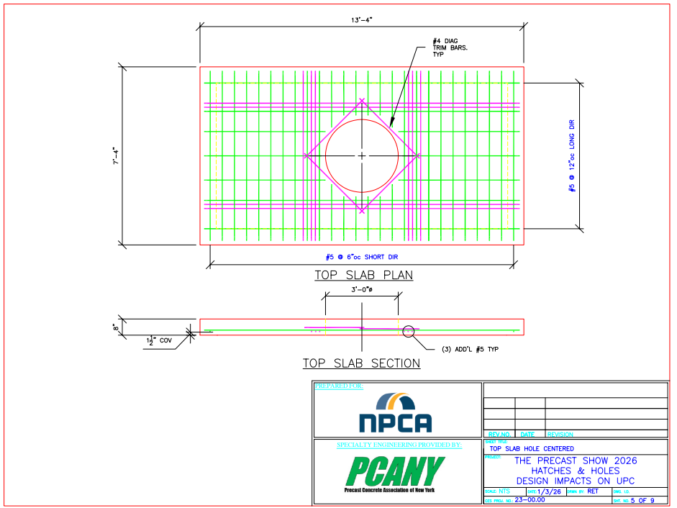
Openings in Slab Systems

Slide 30
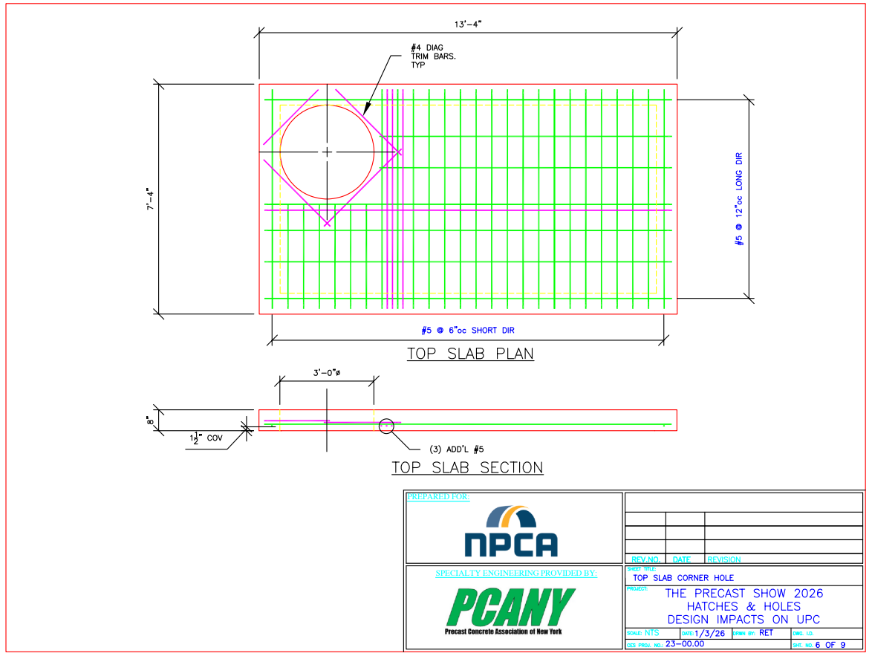
Openings in Slab Systems

Slide 31
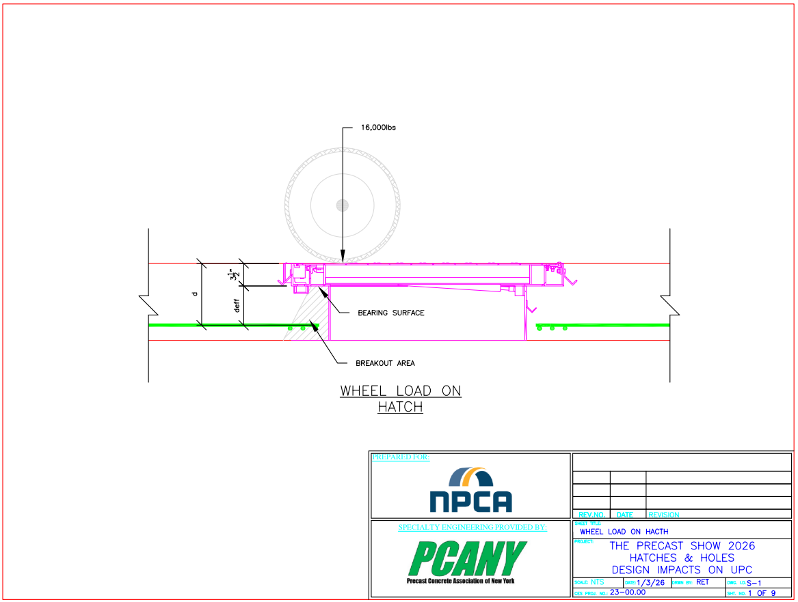
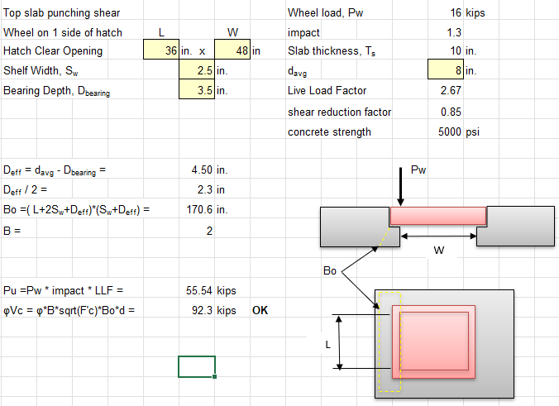
Openings in Slab Systems

Slide 32
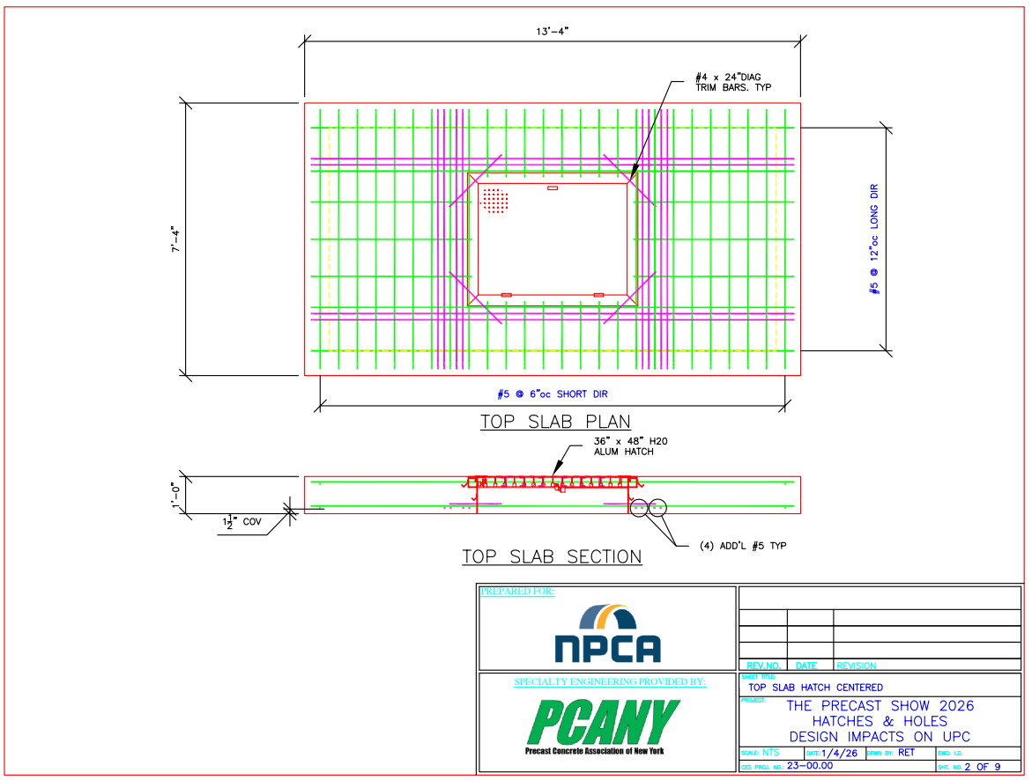
Openings in Slab Systems

Slide 33
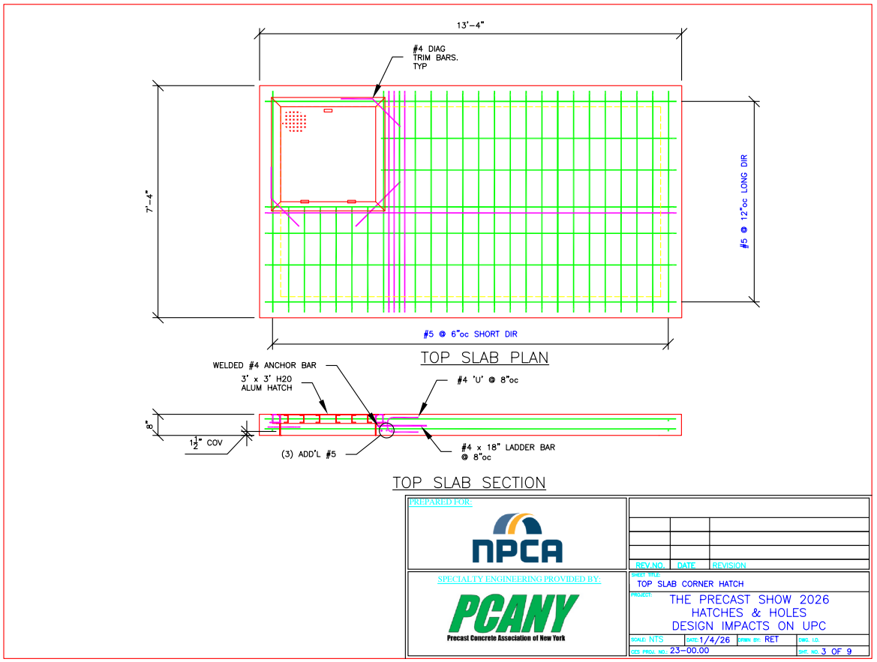
Openings in Slab Systems

Slide 34
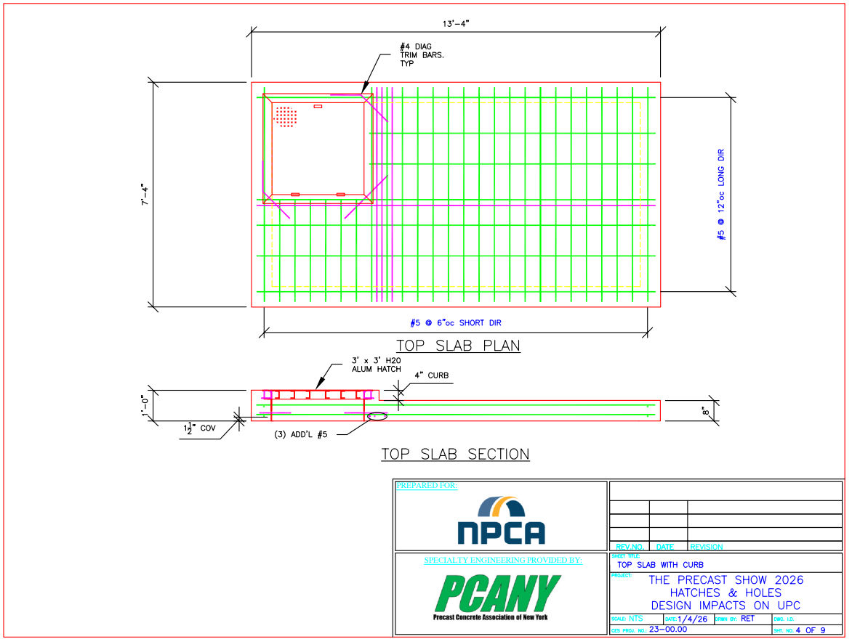
Openings in Slab Systems

Slide 35
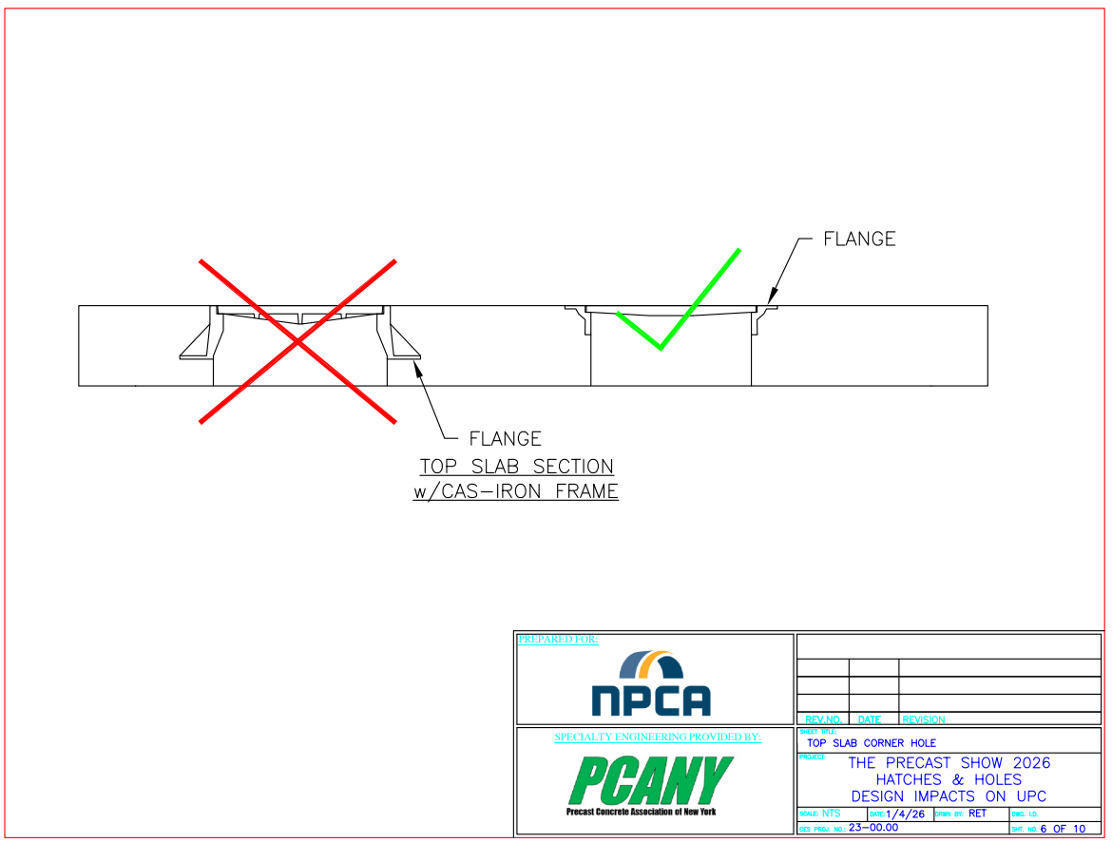
Openings in Slab Systems

Slide 36
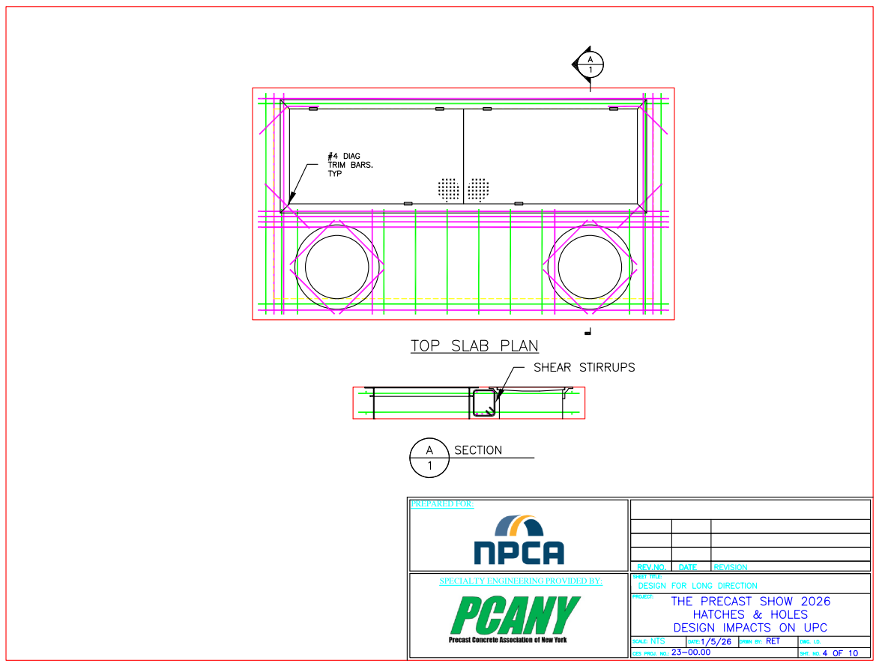
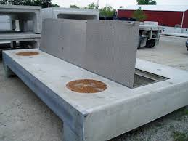
Openings in Slab Systems
Design Beam in the Long Direction

Slide 37
Trim Bars
ASTM C478/C478M
13.4.3 A Layer of reinforcement shall have a minimum area of 0.12in²/linear ft [250mm²/linear m] in both directions.
Openings in flat slab tops shall be additionally reinforced with a minimum of the equivalent of 0.20in² [130mm²] of steel at 90°. Straight rods used to reinforce openings shall have a minimum length equal to the diameter of the opening plus 2in.

Slide 38
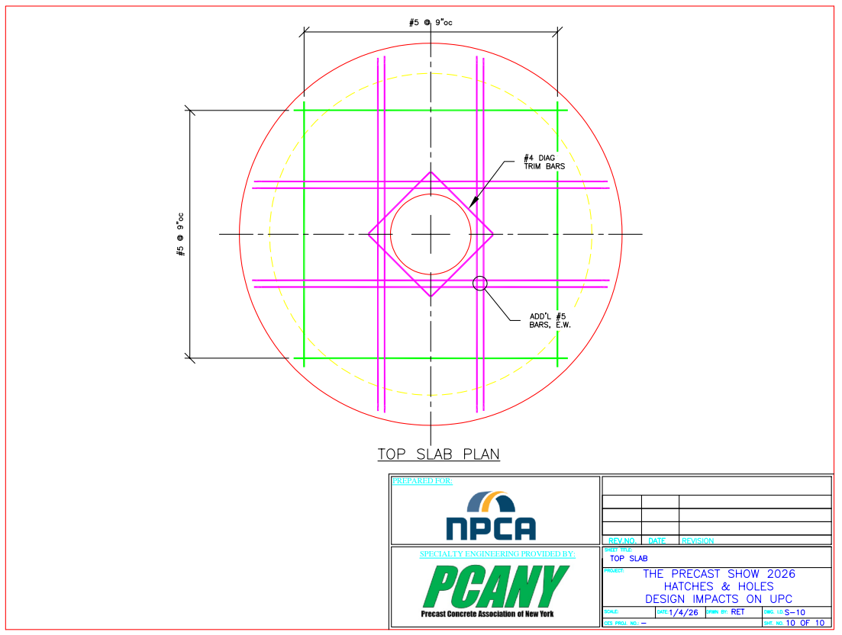
Openings in Slab Systems
Trim bars are not the same as replacement steel

Slide 39
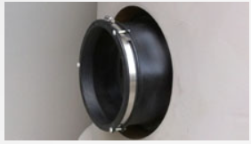
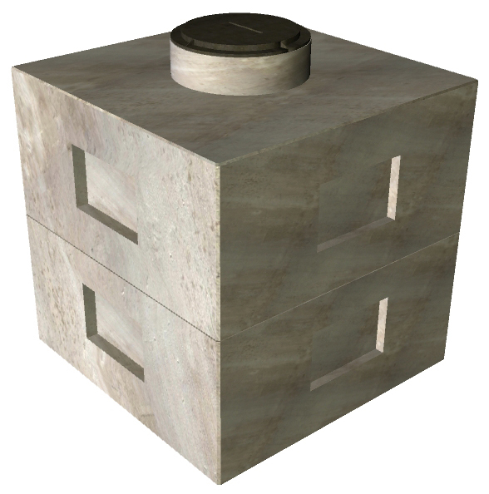
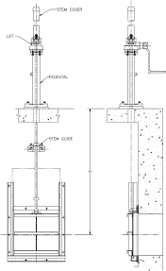
Openings in Walls
Clear openings – Round or Rectangular
Gaskets
Sleeves
Knockouts
Corner Openings – Try to avoid
Slide Gates
Retaining interior or exterior water?
Weirs

Slide 40
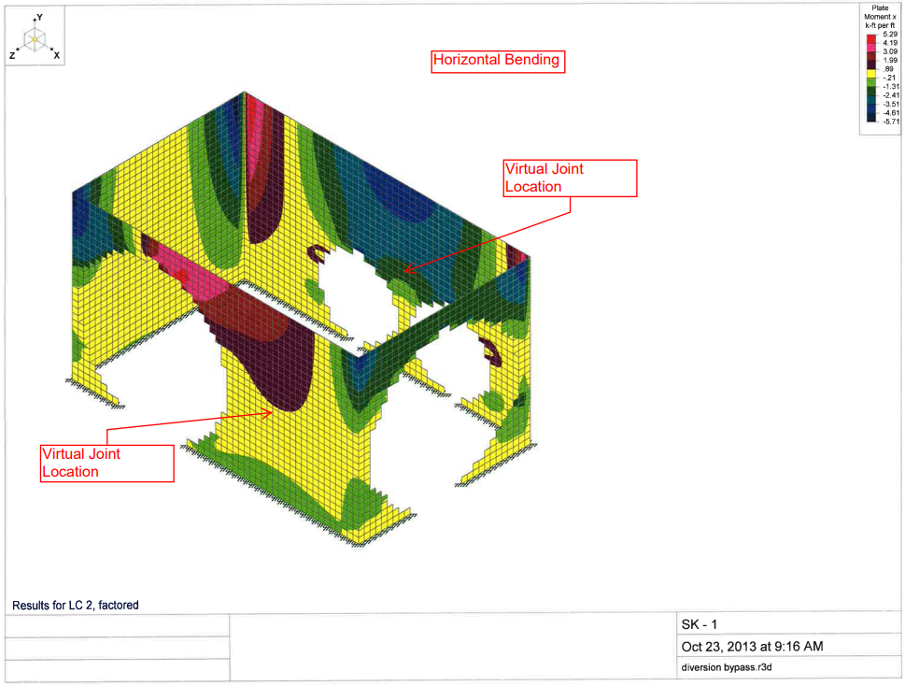
Reinforced Concrete Design
Finite Element Analysis
Accurately shows areas of maximum stress
Time consuming method
Not often justified

Slide 41
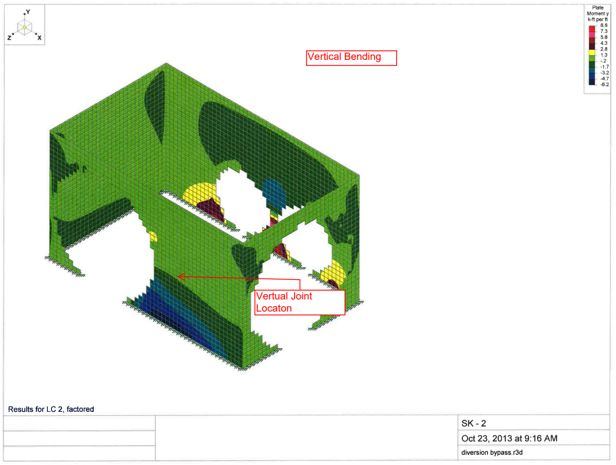
Reinforced Concrete Design
Finite Element Analysis
Accurately shows areas of maximum stress
Time consuming method
Not often justified

Slide 42
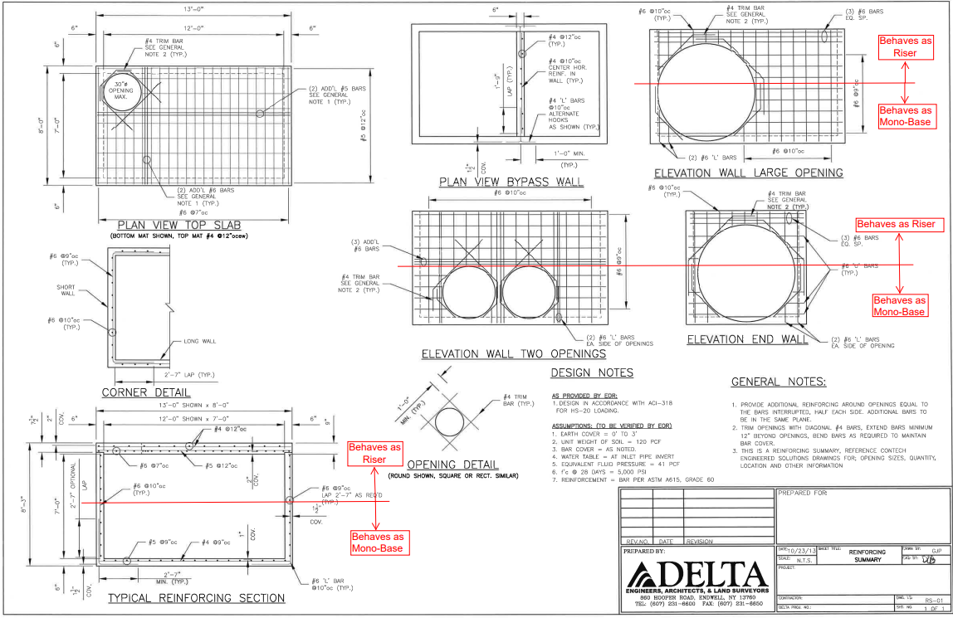
Reinforced Concrete Design

Slide 43
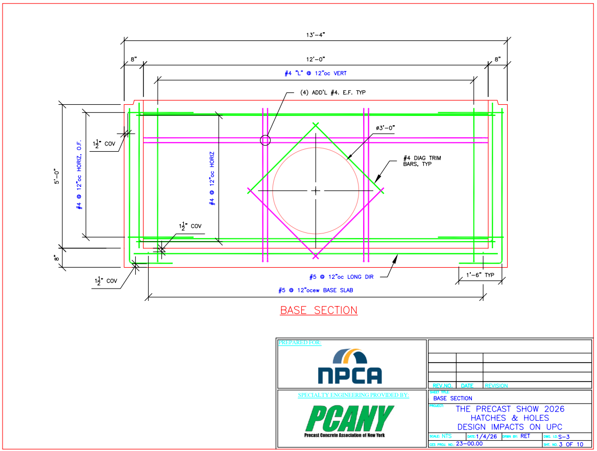
Openings in Slab Systems

Slide 44
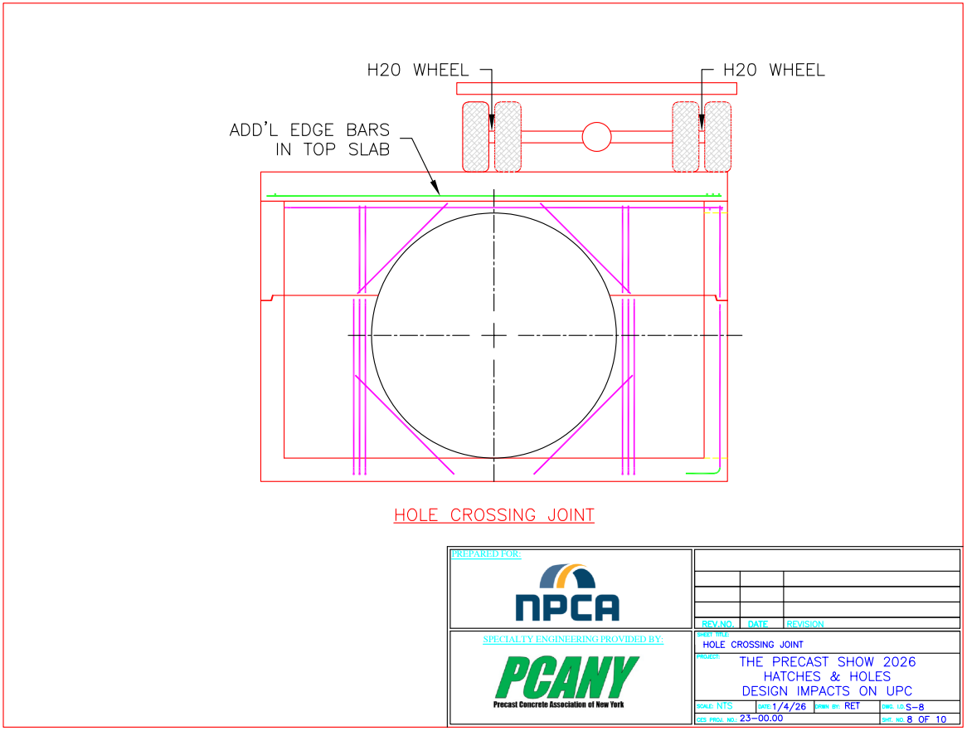
Openings in Slab Systems

Slide 45
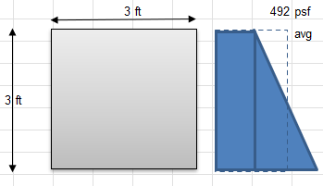
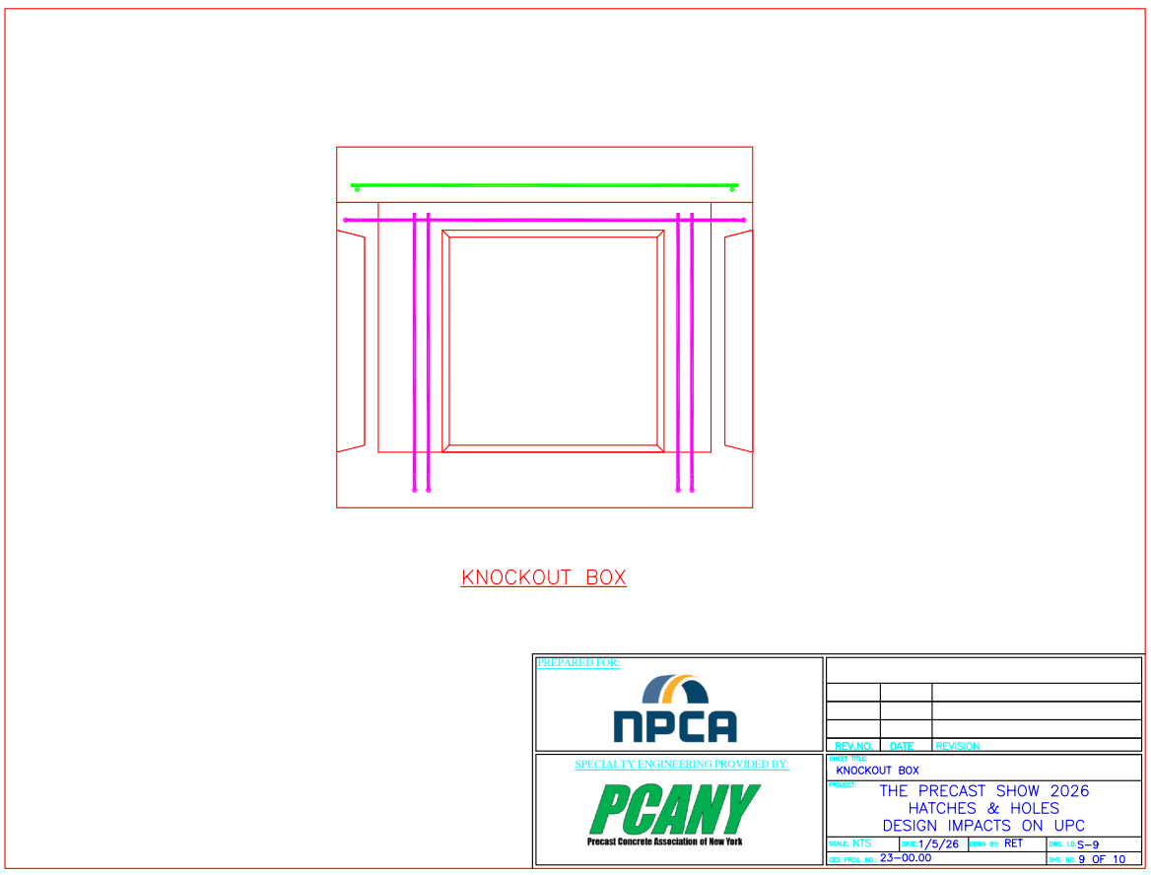
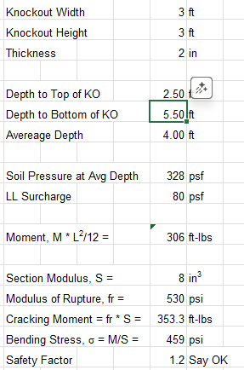
Openings in Slab Systems
THIN WALL
KNOCKOUT
(UNREINFORCED)

Slide 46
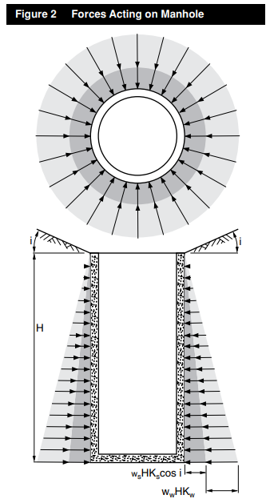

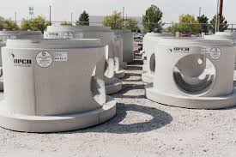
Openings in Slab Systems
Round Manhole Walls

Slide 47
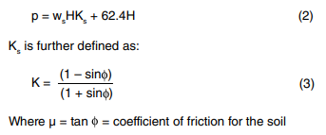
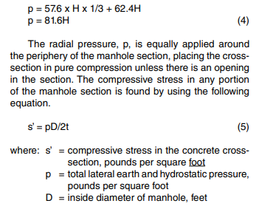
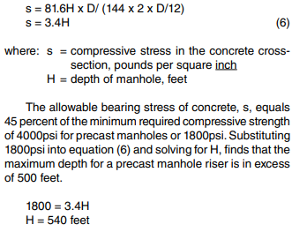
Openings in Slab Systems
Round Manhole Walls

Slide 48
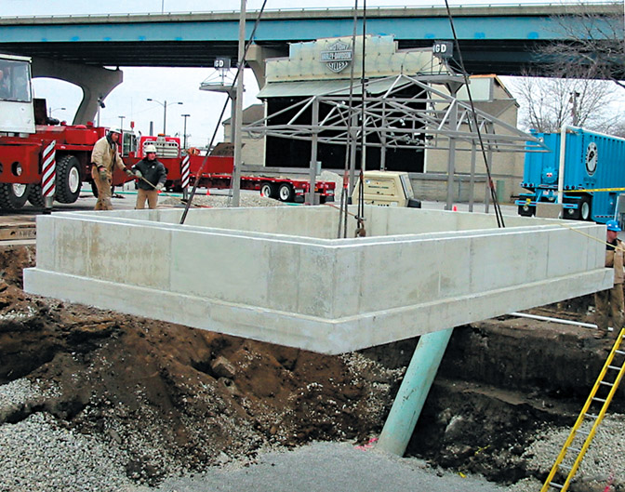
Lifting & Handling
Factors to Consider
Weight of the piece
Center-of-gravity
Member thickness
Direction of lift (shear or tension)
Hook height
Fleet Angle
Concrete Strength
Adhesion to form

Slide 49
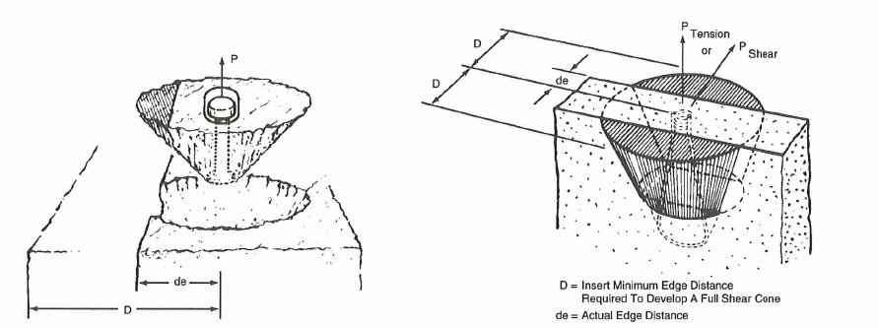
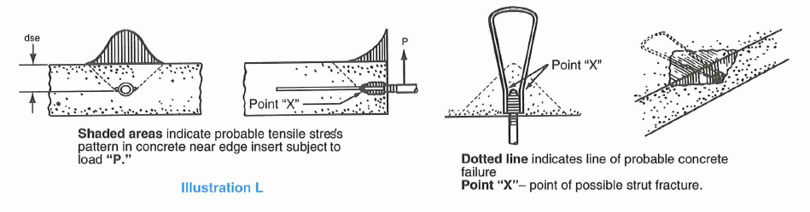
Lifting & Handling
Local Stress
Tension Loading
Shear Loading

Slide 50
Lifting & Handling
Global Stress
Openings will reduce the section that resists bending stress
PCI Design Manual Figure 5.3.2.1

Slide 51
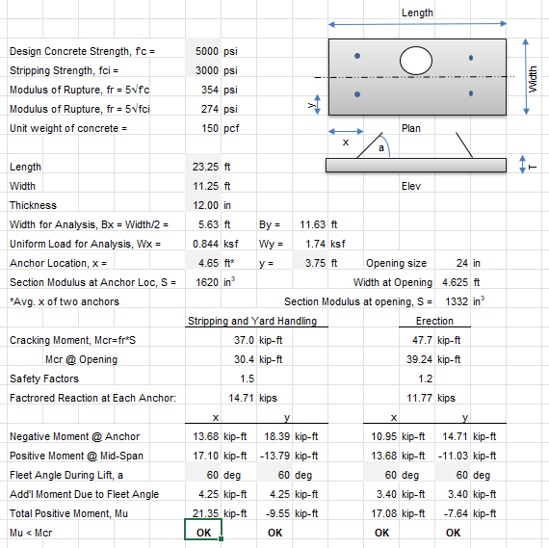
Lifting & Handling
Global Stress
Openings will reduce the section that resists bending stress

Slide 52
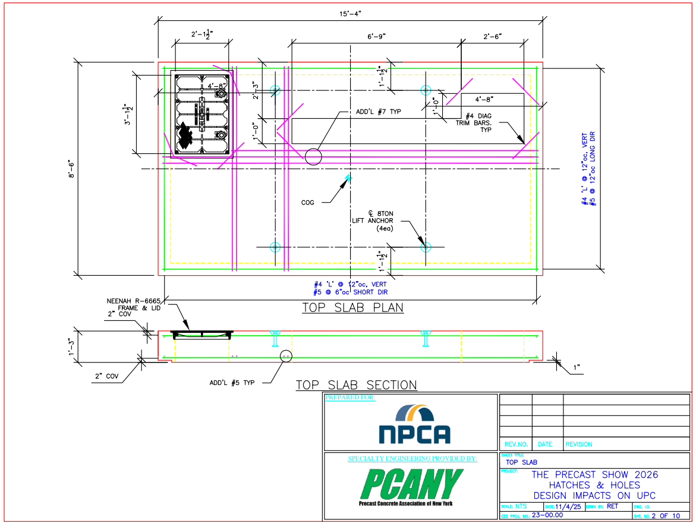
Lifting & Handling

Slide 53
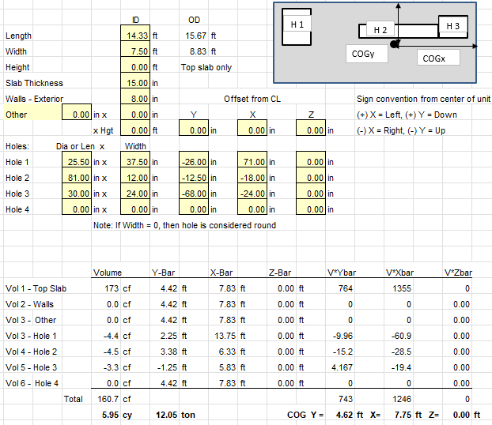
Center-of-Gravity

Slide 54
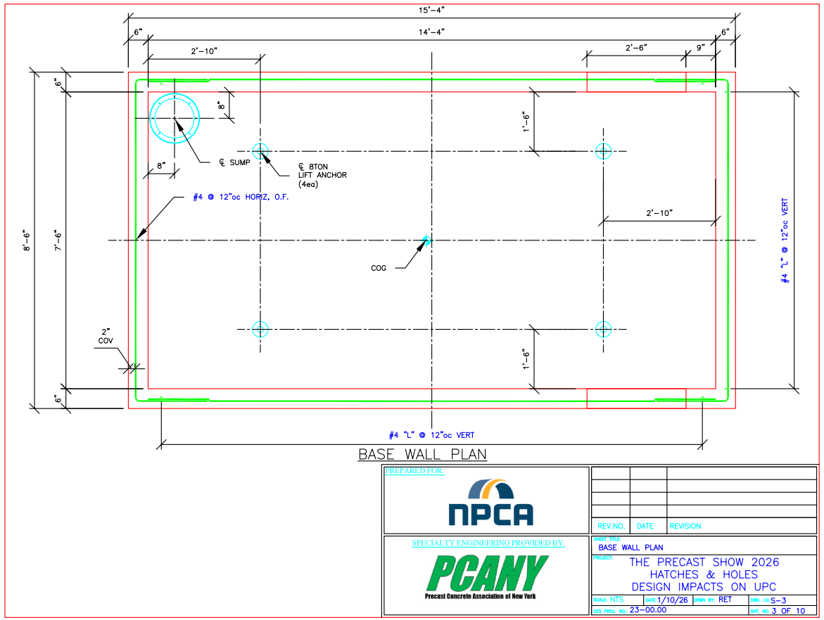
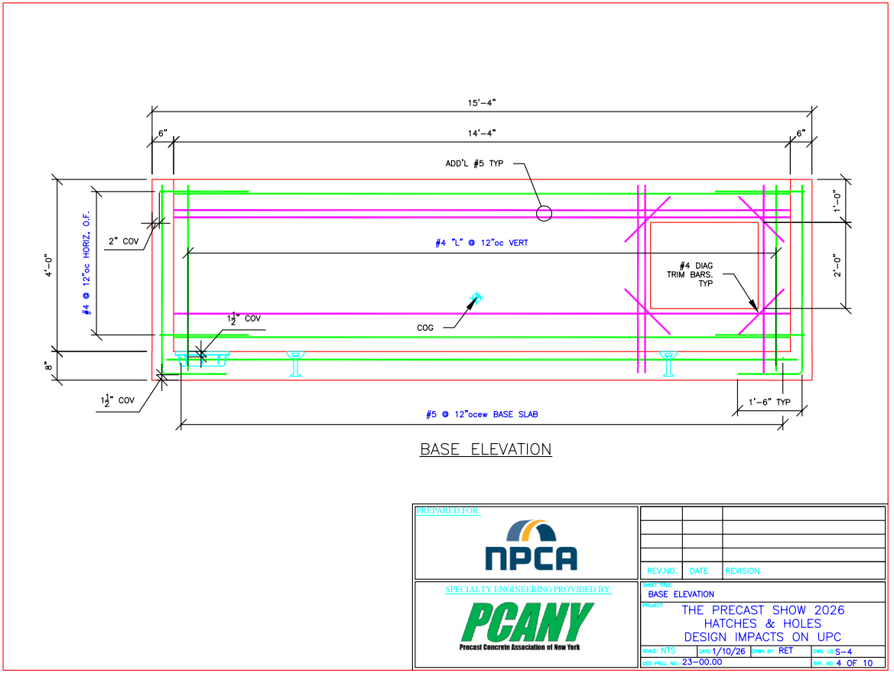
Openings in Slab Systems

Slide 55
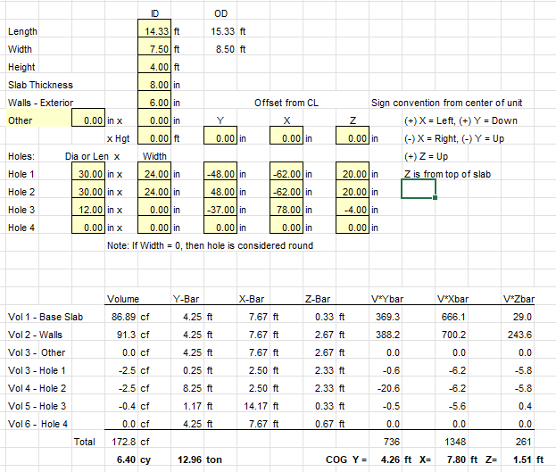
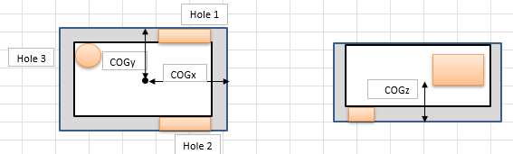
Center-of Gravity

Slide 56
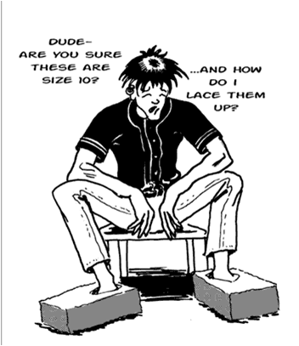
Questions??

Slide 57
Hatches and Holes Design Impacts on Underground Structures
Precast Concrete Association of New York
Ronald Thornton, P.E.
Executive Director

